Slide 1
Java Training Materials and
Application Development Framework
Team No. 3
Dmitrijs Jefimovs
Edgars Praulins
Eric I. Okoroego
Khrystyna Prykhodchenko
Tetiana Priadko

Slide 2
Business analysis
Firstly we made a planner describing the overall task (Planner software)
Defined strategy (communication, softwares needed to solve tasks, share tasks )
Get updates on work in progress

Slide 3
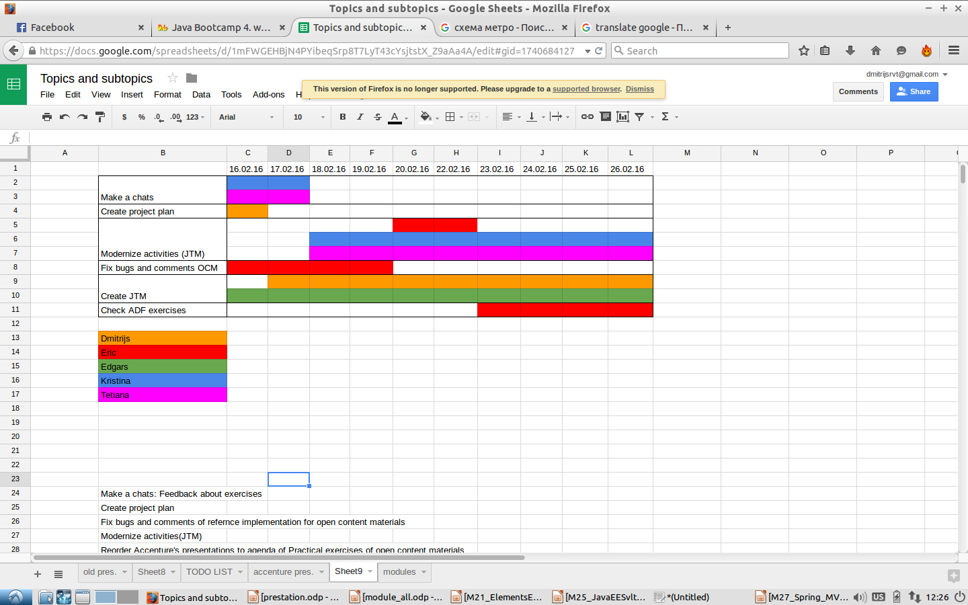
Project planning
Notes:
Here we see project planning.
In screenshot we see that all team members have tasks every day.Thats mean that Efficiency of our team was good.

Slide 4
Transcription
Open content materials*
Application Delivery Fundamentals**
Java Training Materials***
* - OCM
** - ADF
*** - JTM
Notes:
OCM – materials from odo.lv
ADF - private materials from accenture with copyright.
JTM –materials, created by our team.

Slide 5
Version control
Defined strategy (communication, softwares needed to solve tasks, share tasks )
  Git
  Google Docs

Slide 6
Completed work
Make a chats: Feedback about exercises
Create project plan
Fix bugs and comments of refernce implementation for open content materials
Modernize activities(JTM)
Reorder Accenture's presentations to agenda of Practical exercises of open content materials
Fix bugs and comments of refernce implementation for open content materials(ADF)
Check ADF exercises

Slide 7
Chats and feedback about exercises

Slide 8
Feedback about exercises 02-12
Notes:
Hard exercises were Activity 04: "Black Night"(about operators), Activity 06: "Amphibia, Ship, Vehicle and WaterRoad"(about Inheritance).
For almost all of people Activity 12: "Client chat/server"(about NET) was too hard
Easy was Activity 07: "Alien, AlienFromMars, Human, Humanoid"(about Interfaces) and Activity 04: ”If_Switch”(about operators) .
The others exercises were generally OK

Slide 9
Feedback about exercises 13-20 extra 01-06

Slide 10
Average results for practical activities:

Slide 11
Our Tasks:
Checked what was wrong in comments of exercises
Checked what was wrong in description of exercises
Suggest about what and how improve exercises based on feedbacks
Test new developments in exercises and report errors

Slide 12
Done
In all activities checked what was wrong in comments of exercises and in description of exercises. This result was recorded. And after the change has be checked for errors.
For activities was add some ideas how can improve exercises based on feedbacks.

Slide 13
More detailed description
Activity 02: "Hello"
It had to be changed to more harder. After changed it was checked for errors.
Activity 03: "Owl"
In this activity was need to changed wrong comments and unit tests on correct. After changed it was checked for errors.
Activity 04: "Black Knight"
In there was need to do it easier - add extra comments for more understanding what need to do. After changed it was checked for errors.
Notes:
Here we see all tasks, for each excersies.
Suggest about what and how improve exercises based on feedbacks

Slide 14
More detailed description
Activity 05: "Fuel, Road, Transport, Traffic Management System"
In there was need to do it more understanding by make less computation in the exercises. After changed it was checked for errors.
Activity 06: "Amphibia, Vehicle, Ship, Water Road"
In there was need to do it more easier. Also wrote right comments what
expected in Amphibia, Ship, Vehicle; write more understanding comments in Water Road. After changed it was checked for errors.
Activity07: "Alien, Alien From Mars, Human,Humanoid"
This activity need to do a little harder. Was made documents with some consideration about it with example. Pending review.
Notes:
Suggest about what and how improve exercises based on feedbacks

Slide 15
More detailed description
Activity 08: "Tiny Float"
In there need to do write correct comments, in which form expected to see text of throw exception. Expected changes.
Activity 09: "List Set Map"
In there need to write correct comments. Expected changes.
Activity 14: "XML"
For this activity add just considerations - create better “JUnit”, which will be checked not only returned “true” or “false”, and also checked correctness of the execution exercise. Expected review.
Notes:
Suggest about what and how improve exercises based on feedbacks

Slide 16
More detailed description
Activity 17: "Crocodile Game"
In there was need to do it easier, with less logic.
(Have no ideas)
Activity 20: "Lambda expression"
This activity need to do "like a normal exercise".
Was made documents of some consideration about it with example. Expected review.

Slide 17
Compare ADF exercies and Open Content materials

Slide 18
Comments and bug in JTM teacher slides
Comparing TODOs and their explanations
Testing unit AGF and JTM

Slide 19

Comments and bug in JTM teacher slides

Slide 20
Comparing TODOs and their explanations
Basically, there are no much difference between these materials, only some few additional tasks and clear explanations of TODOs in the ADF materials.
ADF materials give a little bit clue that gives focus on the abstractions. (Explanations that clearly guide you to relevant things to do)
Implementations of Java programming idea are mostly done in JTM, students would not have to implement Java programming idea in most cases.

Slide 21
ADF
package com.accenture.adf.newcodington.module10.sample;
/**
* Topic : Inheritance
*
* Description :
*
* The ParkingTryIt.java file will be used during the Try It tasks in the Inheritance module.
* Ensure that you have created the Vehicle and Car classes before running this program
* The error in line 16 is due to the Car class not being available.This will recede after the Car class is created
*/
public class ParkingTryIt {
public static void main(String[] args) {
// TODO Creating a Car object
// TODO displaying the Car properties
// TODO Invoke the drive method for car1
}}

Slide 22
ADF
package com.accenture.adf.newcodington.module6.activity;
/**
*
* CodingtonEventPass is about buying an entry pass which can be used to attend various
* events happening in New Codington
*
* Topic: Activity on Arrays and population of single dimensional array using for loop
*
*/
//TODO 1. Change the class name from 'CodingtonEventPass_TryIt' to 'CodingtonEventPass_Activity1' and save file as 'CodingtonEventPass_Activity1'
//TODO 2. Modify If / Else in checkIfEveningPass() method as below
// a. Modify signature of checkIfEveningPass() method to receive a double parameter additionally
// b. Pass total fare calculated in main() method as a parameter to checkIfEveningPass() method
// c. Declare a float variable for evening additional charge as percentage inside checkIfEveningPass() method
// d. Initialize the evening additional charge as 5 (expressed as percentage)
// e. Modify If condition to apply evening additional charge on the total fare received as parameter
// (total fare = total fare * (1 + (evening additional charge) / 100))
// f. Modify else condition to print 'Regular pass incurs no extra charge' to console
// g. Return total fare from checkIfEveningPass() method
//TODO 3. Change the return type of checkIfEveningPass() to double
//TODO 4. Capture the return value of total fare from checkIfEveningPass() method
//TODO 5. Print total fare to console with a message as 'Total fare after checking for evening pass'
//TODO 6. Save the file

Slide 23
JTM
package main.java.org.activity06;
import main.java.org.activity05.Road;
public class WaterRoad extends Road {
public WaterRoad(String from, String to, int dist) {
// TODO Reuse Road constructor with passed parameters
}
public WaterRoad() {
// TODO reuse Road constructor without parameters
}
// TODO override .toString() method for GroundRoad which returns string in
// form: "Type From — To, 00km"
// HINT use .getClass().getSimpleName() to get Type and reuse toString() of
// Road
public String toString() {
return "";
}
// TODO override .equals() method to return true, if current and ground
// has the same start and end points, distance and type. Note that
// direction is not important, but distance and road type is.
// HINT use super keyword to reuse .equals for Road class and then add just
// additional checks
public boolean equals(Object obj) {
return false;
}}

Slide 24
Testing unit AGF and JTM
Both materials have testing unit but they differ in testing order.

Slide 25
Create Java Training Materials

Slide 26
OCM
ADF
Internet
JTM
Notes:
Ocm, adf, and internet was our souces for java training materials. On lines we see, what actually we took from each source.
All information took from internet is with link.

Slide 27
Materials source
JTM presentations contains:
50 % of ADF
25 % of internet
25 % of OCM
Notes:
JTM presentations caontains of :
50
25
25
We try to maximize amount of text from ADF materials, but some times in adf materials we can't find some topics about Swings, so we try find information in other sources.

Slide 28
Objectives of JTM presentations
Create presentations in this parametrs.
  Slide count 25-40 slidies
  Presentions time will be about 1h +
  Presentation structure from Open Content materials
  Create 21 presentation
Create presentatins more undersnadable, how it is posible.
Format all presentations with same desiogn parametrs.
Add notes where it is important.

Slide 29
Not included information
Introduction to Elements of Enterprise Architecture
Java EE Overview, Servlets, and JSP
Introduction to Spring Framework

Slide 30
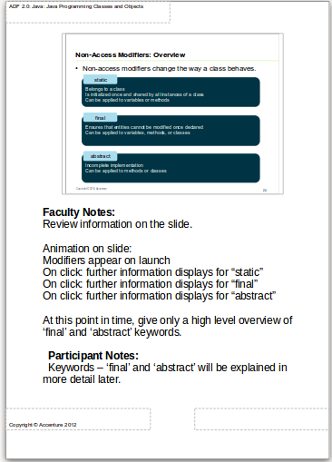
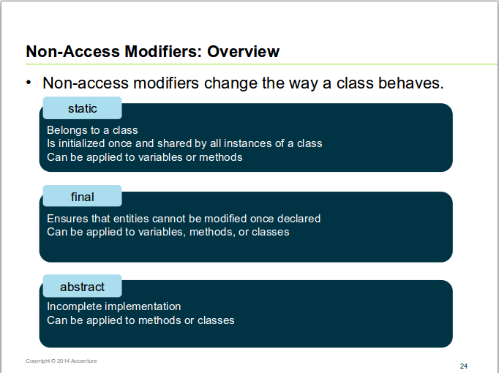
Normal and Notes View
Notes:
A lot of JTM materials have information in notes. Main informatial illustrated on main slide, and more detailed information are in notes.
Reason of this.
Each slide must have less than 3-4 sentences.
Text must be not less than 22 size.
If students want read more information about particular slide, they can read it in notes.

Slide 31
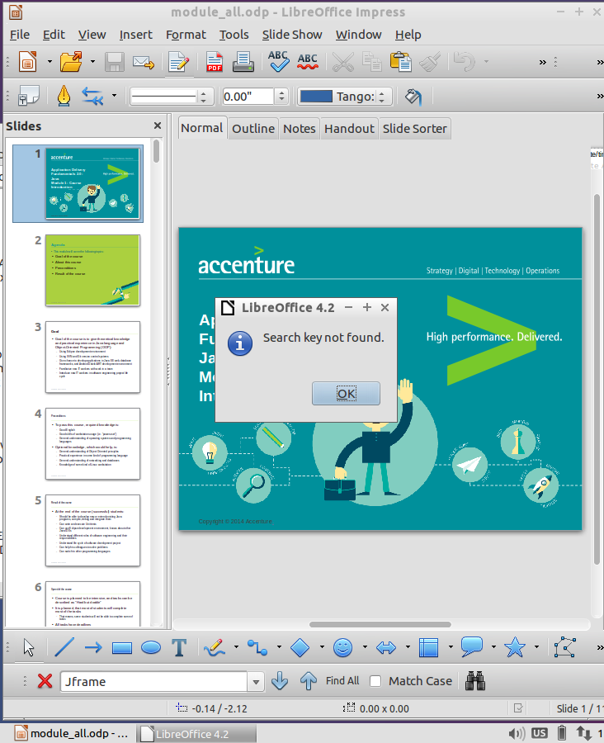

Slide 32
Who to find something in big amount of slides.
All ADF presentations is about 1200+ slides.
Notes:
It is bad idea to open all 40 presentations and try to find something. So we insert all 40 presentations in one presentations. This hint helps to earn a lot of time

Slide 33
Main features of the project
Created new presentations and exercises from student to students.
Took best from ADF and OCM presentations.
Made exercises in same dificulty.

Slide 34
List of team members and their main contribution to project.
Eric:
  Compare ADF exercies
  Fix bugs and add comments in OCM
Kristina:
  Create charts
  Feedback about exercies
  Test exercies(JTM)
Tetiana:
  Create charts
  Feedback about exercies
  Test exercies(JTM)

Slide 35
List of team members and their main contribution to project.
Dmitrijs:
  Project management
  Create JTM presentations
Edgars:
  Create JTM presentations

Slide 36
Biggest challenges in the project and lessons learned.
Biggest challenge was to write understandable training materials.
Another big challange was of practical lesson impovment.
Defining correct project tasks and team management.

Slide 37
Future work
Create JTM presentations for 3 week.
Modernize knowledge checks.
Redo exercies 11-20 + extra exercies.

Slide 38
Any questions?

